Slide 1
STRING

Slide 2
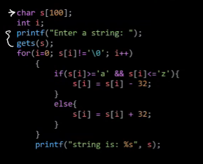

Slide 3
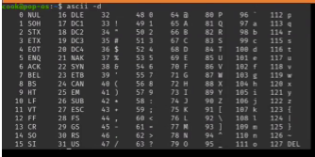

Slide 4
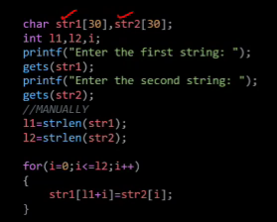

Slide 6
POINTER

Slide 7


Slide 13
int a = 10, b = 20, c;
int *p, *q;
p = &a;
q = &b;
c = *q;
printf("a=%d\n", a);
*p = 20;
printf("Value of a=%d\n", a);
printf("value of a(using pointer)=%d\n", p);

